Slide 1
REAL TIME PROJECT

Slide 2

GAS LEAKAGE ALERT SYSTEM
PRESENTED BY :
GUIDED BY:
V.Lohitha (23P61A12B9)
M.Sumana Sri (23P61A1273)
V.Sai Ram (23P61A12C2)
Mr K.Venkat reddy sir
(Assistant Professor)
INFORMATION TECHNOLOGY

Slide 3
Content
literature survey on automatic street light system iot project
Abstract
Introduction
Problem Statement
Objective
Review of Existing System
Proposed Solution
Architecture
Technologies and Tools/Components Required
Conclusion
Smart Rooftop Rainwater Harvesting System (SRRHS)

Slide 4
1.ABSTRACT
Gas leakage alert system using gas sensor and Arduino uno. Gas leakage is a serious hazard that can lead to explosions, poisoning, and severe environmental damage. This project aims to design and implement a gas leakage detection and alert system using an MQ-series gas sensor, Arduino UNO, and a GSM module. When the sensor detects a gas concentration exceeding a predefined threshold, the Arduino processes the data and triggers an alert. The system then sends an SMS notification and makes an emergency call to predefined contacts, such as homeowners, safety officers, or emergency services. This real-time alert mechanism enhances safety by enabling quick responses to gas leaks in homes, industries, and laboratories. The system is cost-effective, easy to implement, and scalable for various applications.
5

Slide 5
2.Introduction
Purpose: GAS LEAKAGE ALERT SYSTEM is a gas safety monitoring system designed to detect hazardous gases in various environments.
Target Gases: It detects gases like carbon monoxide (CO), carbon dioxide (CO2), methane (CH4), oxygen (O2), and more.
Real-time Monitoring: Provides continuous, real-time monitoring with instant alerts for unsafe gas levels.
Advanced Sensors: Uses precise and reliable sensors for accurate gas detection.
User-friendly Interface: Easy-to-use system for monitoring and managing gas levels.
Remote Access: Allows remote monitoring and alert notifications from anywhere.
Automatic Calibration: Ensures accurate operation with minimal manual intervention.
Industry Integration: Integrates smoothly with existing safety infrastructure and protocols.
Regulatory Compliance: Helps organizations meet safety regulations and standards.
Applications: Suitable for industrial, commercial, and residential environments, enhancing overall safety.
7

Slide 6
3. Problem statement
The GAS LEAKAGE ALERT SYSTEM project aims to address the critical safety risks posed by hazardous gas leaks in various environments by providing an accurate, real-time, and automated gas detection system to ensure timely response and regulatory compliance.
7

Slide 7
4. Objective
Real-Time Gas Monitoring: Provide continuous monitoring of hazardous gases in various environments.
Accurate Detection: Ensure precise and reliable detection of gases like CO, CO2, methane, and oxygen.
Timely Alerts: Deliver immediate notifications when gas levels reach unsafe thresholds.
Safety Compliance: Help organizations meet safety regulations and standards related to gas monitoring.
Integration and Scalability: Offer a scalable system that integrates easily into existing safety infrastructure.
7

Slide 8
5. Review of existing system
Existing gas detection systems often face several limitations, including inaccurate gas readings, reliance on manual monitoring, and difficulties with integration into broader safety protocols. Many of these systems require frequent calibration and maintenance, increasing both time and cost. Additionally, real-time alerts may not be provided, delaying response to potential gas hazards. Furthermore, scalability is often an issue, as many systems are not adaptable to both small and large-scale environments. In contrast, the GASGUARD project offers an advanced solution by ensuring accurate detection, real-time notifications, seamless integration, and scalability, addressing the shortcomings of current systems and providing enhanced safety and reliability.
7

Slide 9
6. Proposed solution
The proposed GAS LEAKAGE ALERT SYYSTEM is an advanced gas detection and monitoring solution designed to provide real-time, accurate tracking of hazardous gas levels. Using state-of-the-art sensors, the system will continuously monitor gases like carbon monoxide, carbon dioxide, methane, and oxygen, alerting users instantly when unsafe gas concentrations are detected. GASGUARD will offer automated calibration, reducing manual intervention, and ensuring consistent accuracy. With a user-friendly interface and remote monitoring capabilities, the system can be seamlessly integrated into existing safety infrastructures, making it scalable for both small and large environments. This comprehensive solution aims to enhance safety, minimize risks, and ensure regulatory compliance across various industries.
7

Slide 10
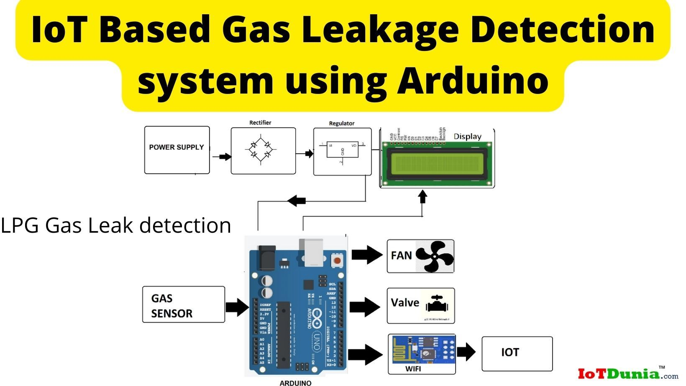
ARCHITECTURE
Here’s the architecture for the GAS LEAKAGE ALERT SYSTEM project in short, in points:
Gas Sensors: Detect hazardous gases (e.g., CO, CO2, methane, oxygen) in real-time.
Central Processing Unit (CPU): Processes sensor data to determine if gas levels exceed safe limits.
User Interface: Displays real-time gas concentrations and sends alerts via email, SMS, or app notifications.
Cloud-Based Platform: Allows remote access, monitoring, and data storage for easy management.
Automatic Calibration: Ensures accuracy by reducing manual intervention and maintaining system performance.
Integration with Safety Systems: Seamlessly connects to existing safety protocols for a comprehensive safety solution.
Scalable Design: Adaptable for both small and large environments, providing flexibility in deployment.
7

Slide 11
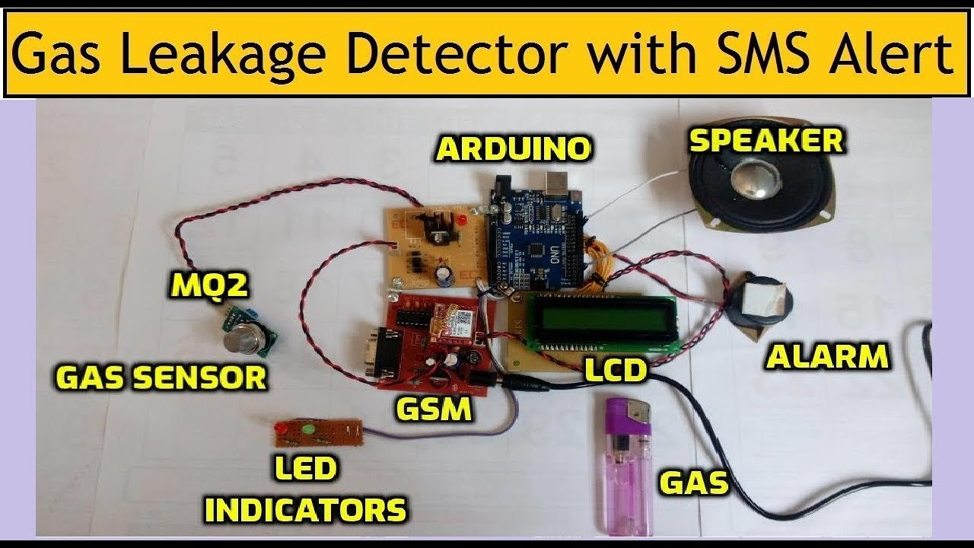
8. Technologies and Tools/ Components Required
For the GASGUARD project using Arduino, the required technologies, tools, and components are:
Arduino Board: (e.g., Arduino Uno, Arduino Mega) as the central processing unit to manage data and control sensors.
Gas Sensors: (e.g., MQ series sensors like MQ-2, MQ-7, MQ-9) to detect gases like CO, CO2, methane, and LPG.
Wi-Fi/Bluetooth Module: (e.g., ESP8266, ESP32, or HC-05 Bluetooth) for communication and sending alerts remotely.
OLED/LCD Display: To display real-time gas levels locally on the device.
Relay Module: To control external devices like ventilation systems or alarms when unsafe gas levels are detected.
Power Supply: Batteries or a 5V adapter to power the Arduino and sensors.
Buzzer/LED: For local alerts, indicating when dangerous gas levels are detected.
Cloud Integration: Use of services like ThingSpeak or Blynk for cloud-based data storage and remote monitoring.
Alert System: (e.g., Twilio API for SMS notifications or Firebase for push notifications) to send alerts to users when unsafe levels are detected.
Cables & Connectors: For wiring sensors and modules to the Arduino board.
These components, combined with Arduino programming, provide an efficient, cost-effective solution for real-time gas monitoring and alerting in the GASGUARD project.
7

Slide 12
9. Conclusion
In conclusion, the GAS LEAKAGE ALERT SYSTEM project offers an innovative and reliable solution for real-time monitoring of hazardous gases, enhancing safety in industrial, commercial, and residential environments. By utilizing Arduino-based technology, advanced gas sensors, and cloud integration, GAS LEAKAGE ALERT SYSTEM provides accurate detection, timely alerts, and seamless integration with existing safety systems. This project ensures that potential gas hazards are quickly identified and addressed, reducing risks, improving safety compliance, and offering scalable protection across diverse environments.
7

Slide 13
THANK YOU

